Slide 1
ECE 333
Green Energy Systems
Lecture 13: Introduction to Wind Power
Dr. Karl Reinhard
Dept. of Electrical and Computer Engineering
University of Illinois at Urbana-Champaign
reinhrd2@illinois.edu

Slide 2
Announcements
Start Wind Power Today
No Homework / Quiz this week
Homework 7 / Quiz 7 Thursday after Spring Break
Reading Chapter 7
Thanks to EOH Volunteers – GREAT SUCCCESS

Slide 3
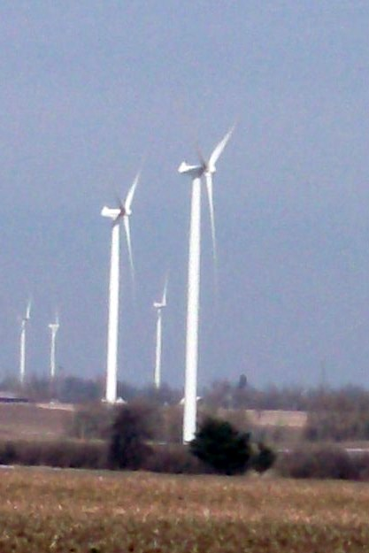
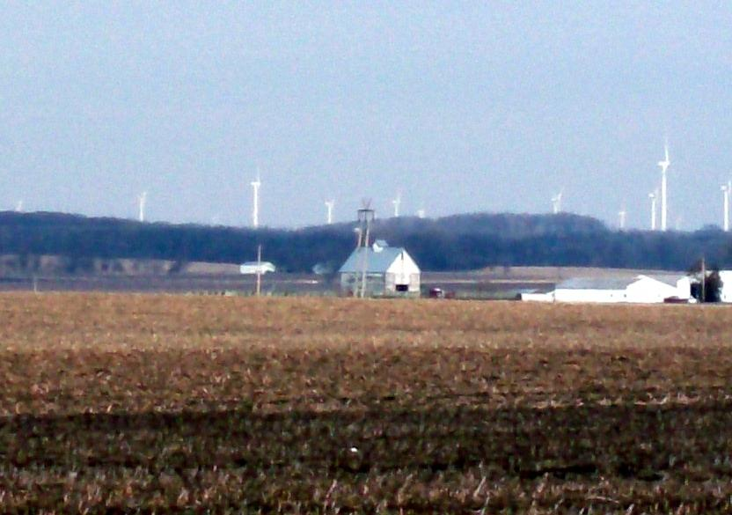
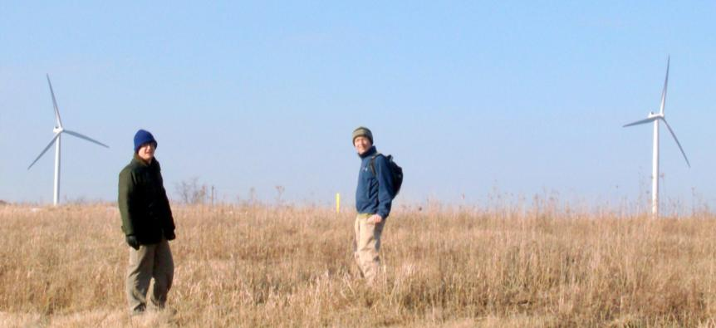
Wind Power Systems
Notes:
2

Slide 4
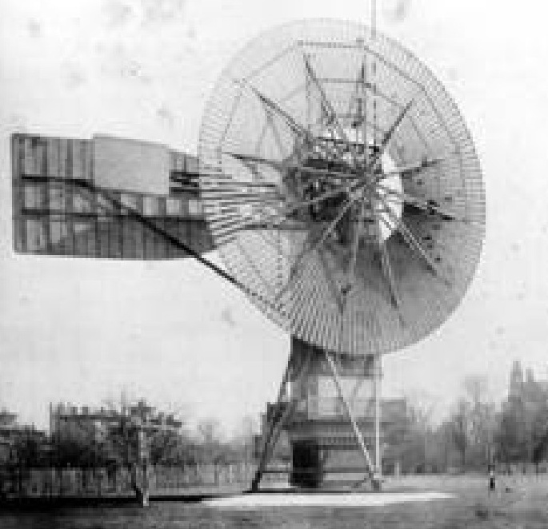
Wind Power in History
Charles F. Brush installed 1st known wind turbine to produce electricity in 1888 – a 12 kW turbine that charged batteries to power his Cleveland, Ohio mansion
By 1930s and 1940s, hundreds of thousands were in use in rural areas not yet served by the grid
Interest in wind power declined as the utility grid expanded and as reliable, inexpensive electricity could be purchased
http://www.windpower.org/en/pictures/brush.htm
1970’s brought inflation, increased fossil-fuel prices, supply shortfalls (Arab oil embargo), calls for conservation, and growing environmental concerns → Electricity rates rose
U.S. Congress passed Public Utilities Regulator Policies Act (PURPA) in 1978, which mandated utilities purchase power from independent generators located in their service territory (modified 2005)
Notes:
3

Slide 5
Wind Power in History (cont)
PURPA* introduced competition
  Allowed customers to build on-site generation & be grid connected
  Required Utilities to purchase from qualifying facilities (QFs)
  Gave birth to the electric side of renewable energy industry
Enabled the significant small producer renewable energy production growth in the 80’s:
  Req’d utilities to purchase from qualifying facilities (QF): < 80 MW and 75% renewable energy source wind, solar, geothermal, etc.
  During the 1980’s, California added ~ 6000 MW of QF capacity : 1600 MW wind, 2700 MW geothermal, and 1200 MW biomass
In the 90’s, 10-year QFs contracts (@$60/MWh in 80’s) were no longer competitive (profitable) @ $30/MWh in 90’s … → many sites were retired or abandoned
* Public Utilities Regulator Policies Act (PURPA) 1978

Slide 6
Wind Power in History (cont)
Major opening of industry to competition occurred as a result of National Energy Policy Act of 1992 (EPAct of 92)
  Goal was to set up true competition in generation
  Mandated “nondiscriminatory” access to the Hi Volt transmission
  Major electric power industry restructuring – breaking industry into 3 segments – Generators, Transmitters, Distributers
EPAct of 2005 repealed PUHCA; modified PURPA
Energy Independence and Securty Act of 2007 (EISA 2007) aimed to promote
  the production of clean renewable fuels,
  the efficiency of products, buildings, and vehicles,
  research on and deployment of greenhouse gas capture and storage options
Notes:
5

Slide 7
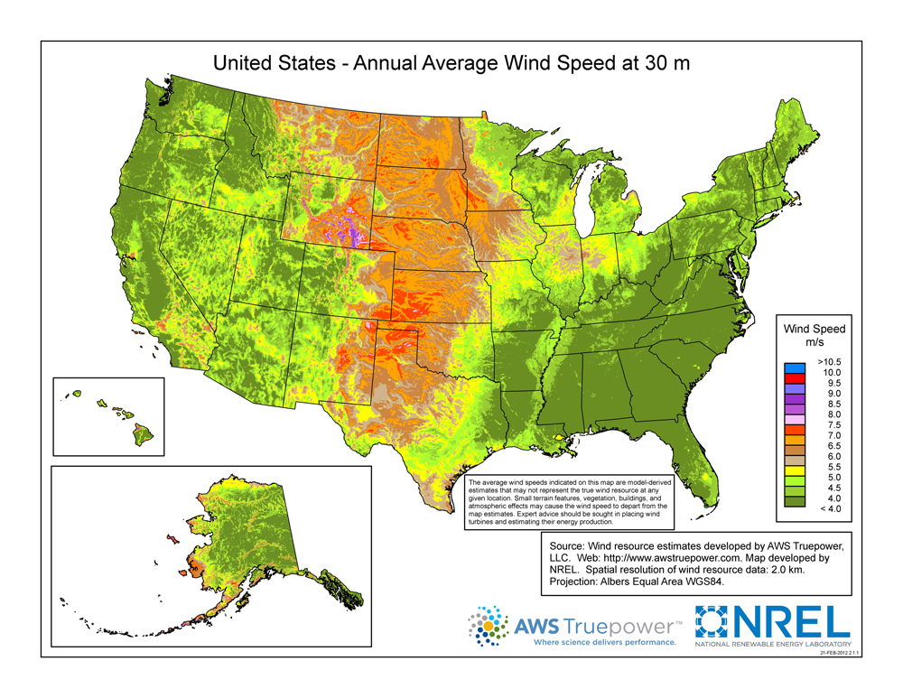
Residential Scale
Data 21 Feb 2012
Downloaded 14 Mar 17
http://www.nrel.gov/gis/images/30m_US_Wind.jpg
Notes:
6

Slide 8
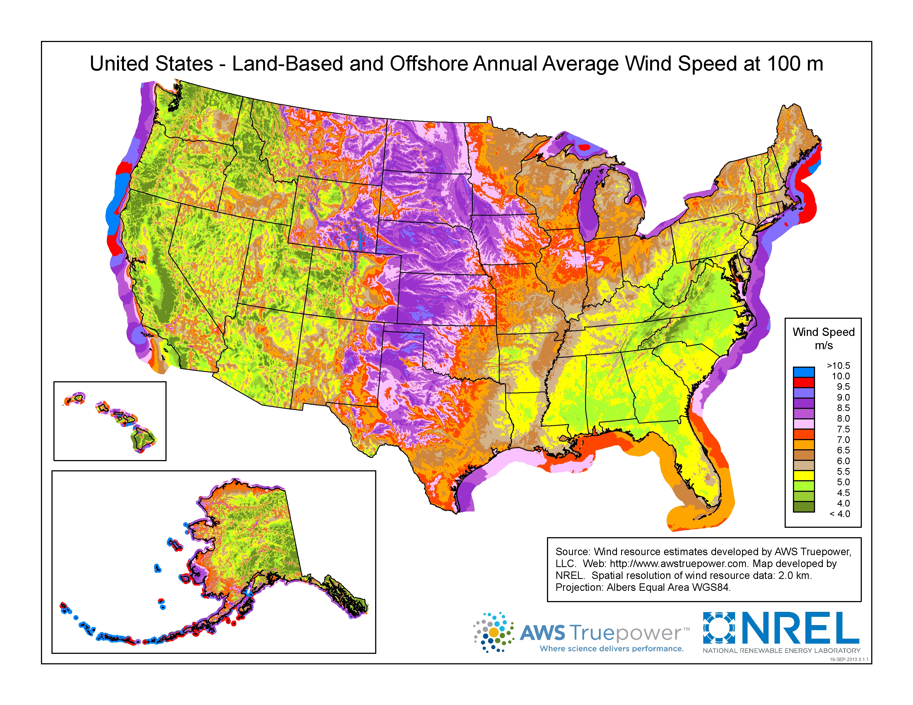
Utility Scale
Data 19 Sep 2013
Downloaded 14 Mar 17
80 meters
http://www.nrel.gov/gis/images/100m_Wind/awstwspd100onoff3-1.jpg

Slide 9
Projected Turbine Blade Length Growth
(North America – Land-based)
https://emp.lbl.gov/sites/all/files/scaling_turbines_1.pdf

Slide 10
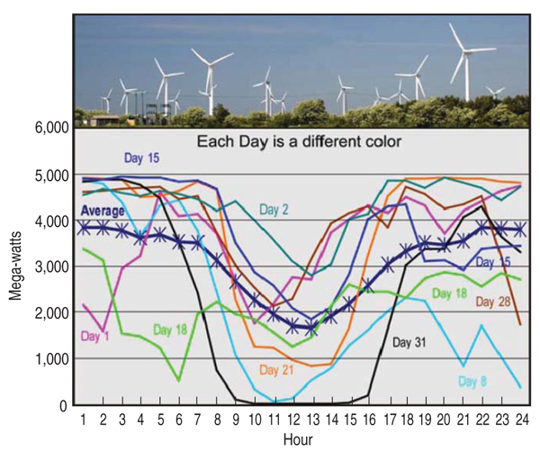
Wind Power Availability?!
http://www.tms.org/pubs/journals/JOM/1009/fig1.jpg

Slide 11
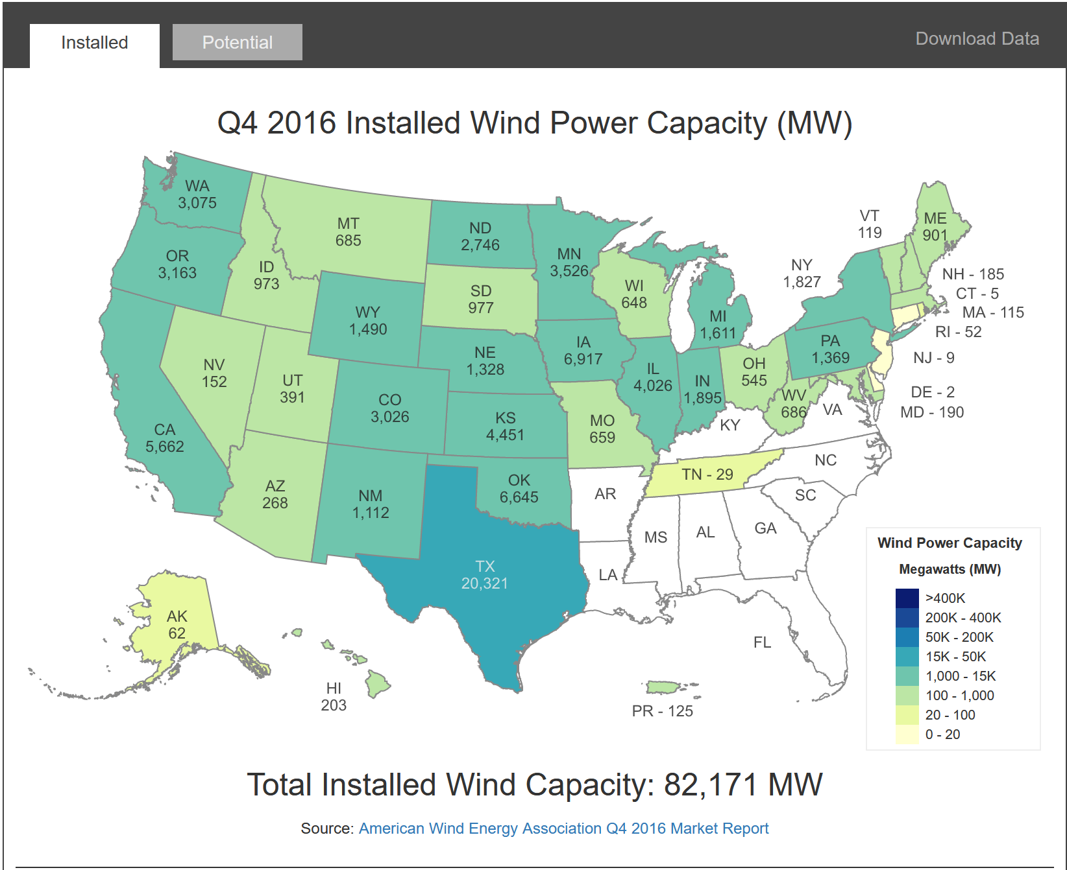
US Installed Wind Capacity – 2016
http://apps2.eere.energy.gov/wind/windexchange/wind_installed_capacity.asp
Notes:
10

Slide 12
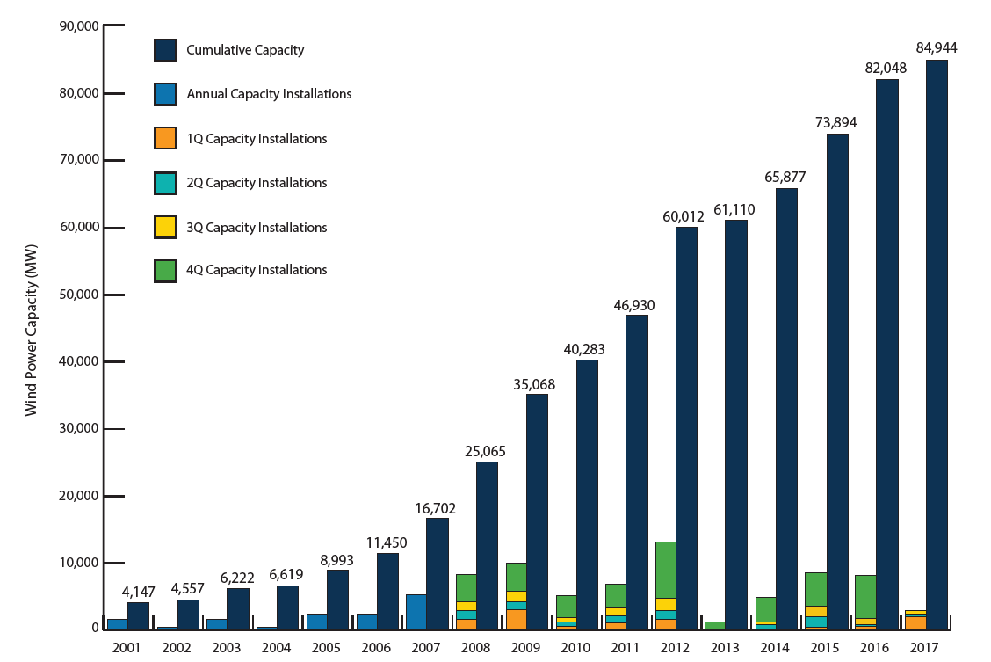
Growth in US Wind Power Capacity
Total U.S. installed wind capacity, through end of 2017: |  | 84, 944 MW
For AWEA reports: http://www.awea.org/wind-energy-facts-at-a-glance accessed 12 Mar 18

Slide 13
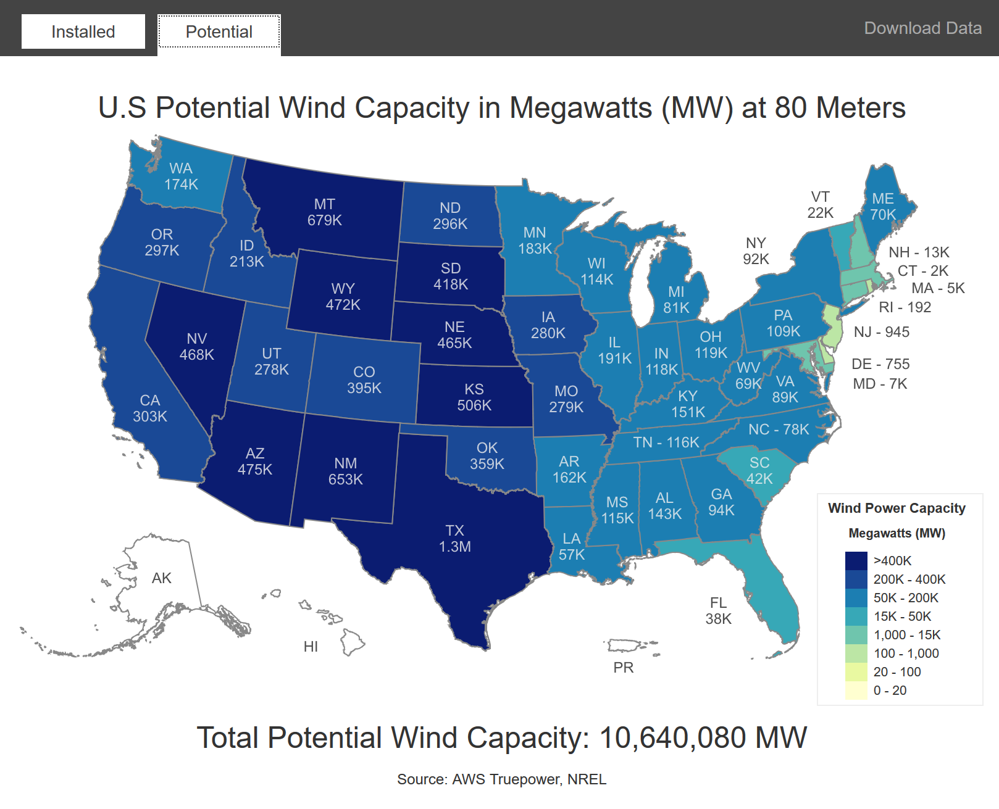
Estimated Total U.S. Capacity
http://apps2.eere.energy.gov/wind/windexchange/wind_installed_capacity.asp
Notes:
12

Slide 14
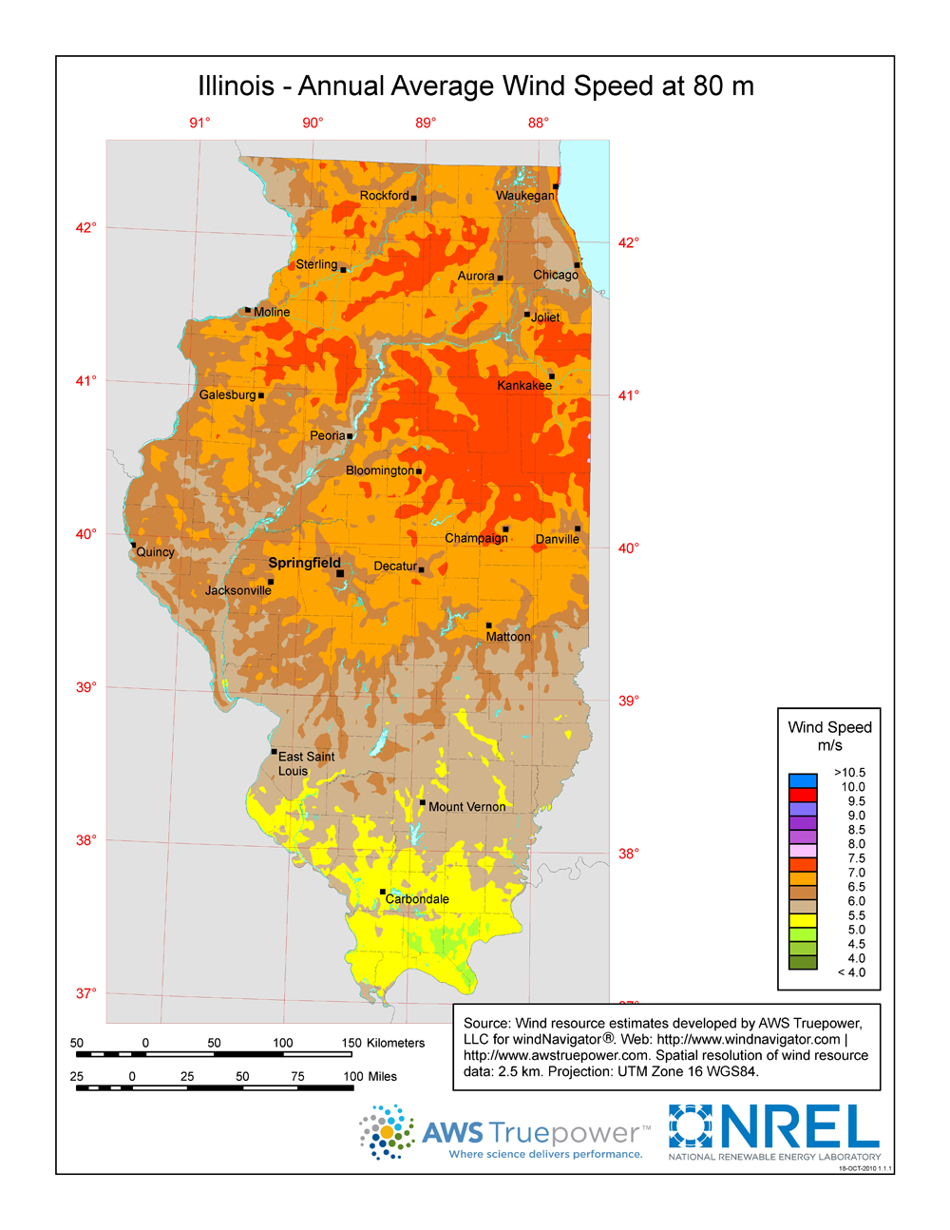
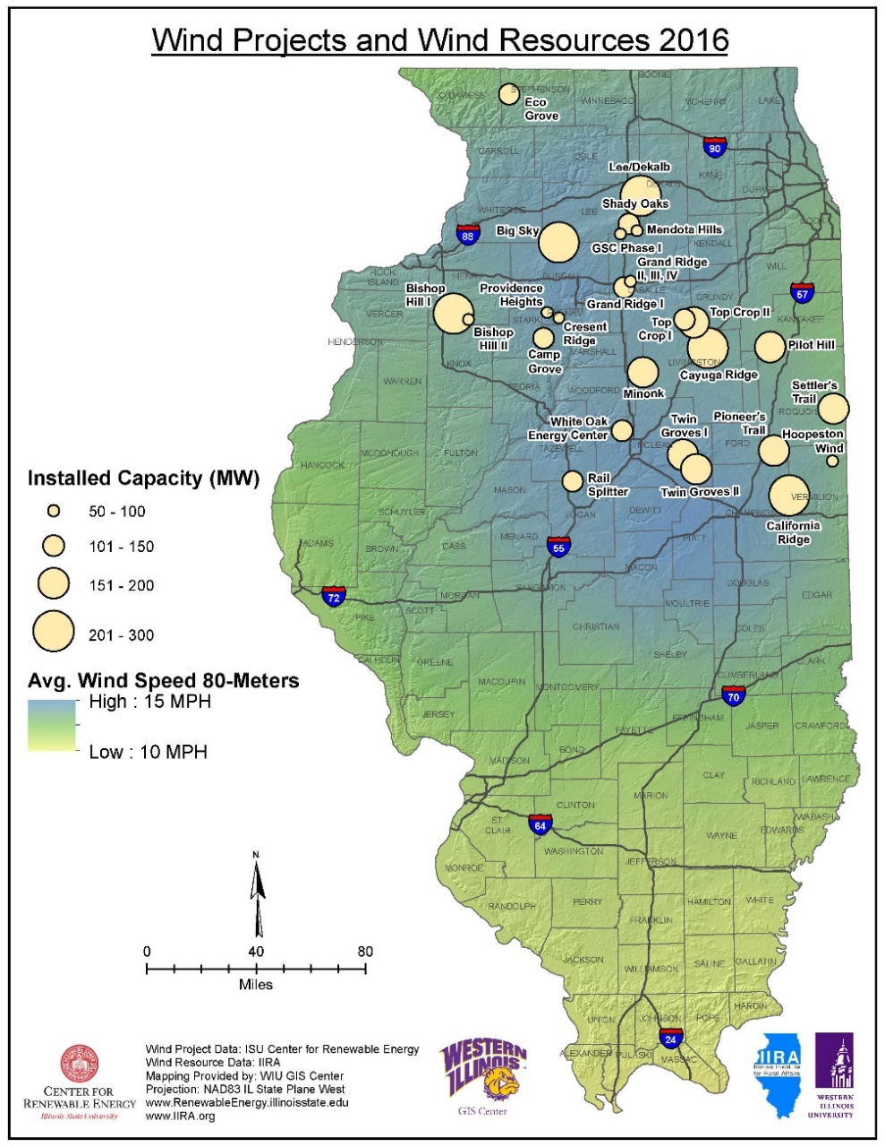
IL Wind Data Maps
Data 15 Oct 2010
Downloaded 14 Mar 17
http://apps2.eere.energy.gov/wind/windexchange/wind_resource_maps.asp?stateab=il

Slide 15

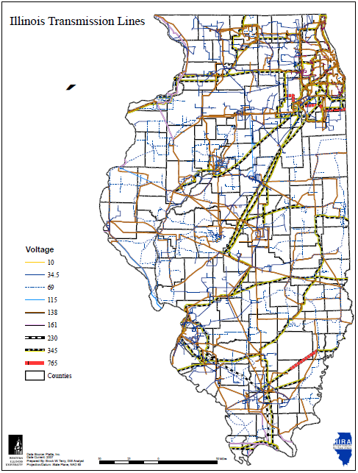
Wind Power Transmission
http://www.illinoiswind.org/wp-content/uploads/2014/05/WindProjectsResources2016.pdf
http://www.illinoiswind.org/
(No longer posted – 14 Mar 17)

Slide 16
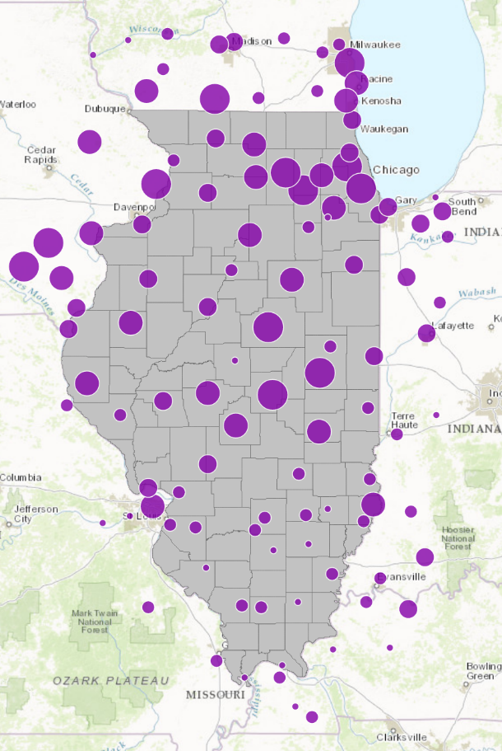
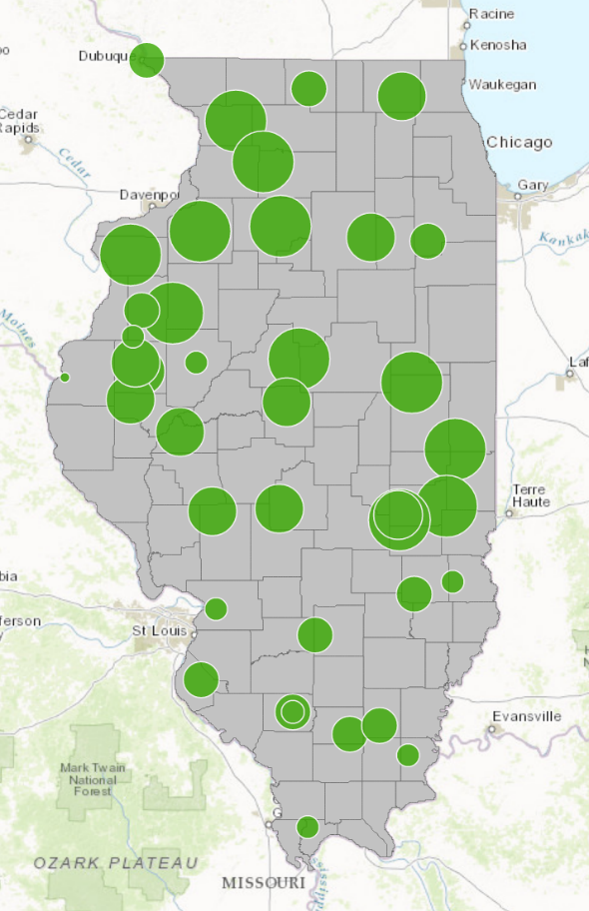
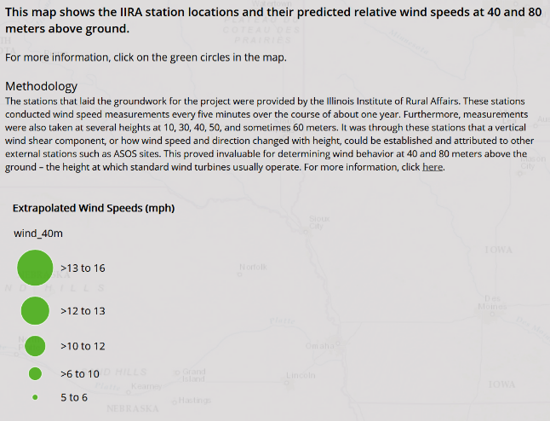
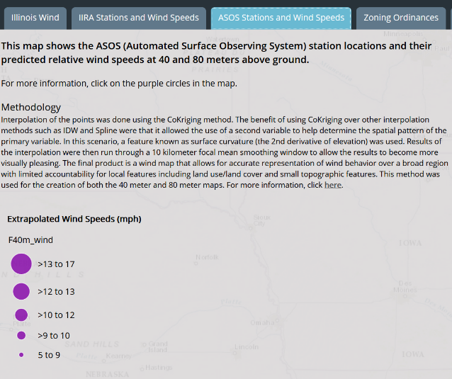
Illinois Wind Data
Wind speed measurements → wind energy production estimates
Illinois wind resource www.illinoiswind.org
  Wind measurement data across Illinois
  Wind resource maps for Illinois
http://wiu-gis-center.maps.arcgis.com/apps/MapSeries/index.html?appid=f3f04fb190134cdeab27a0cf79ce1744

Slide 17
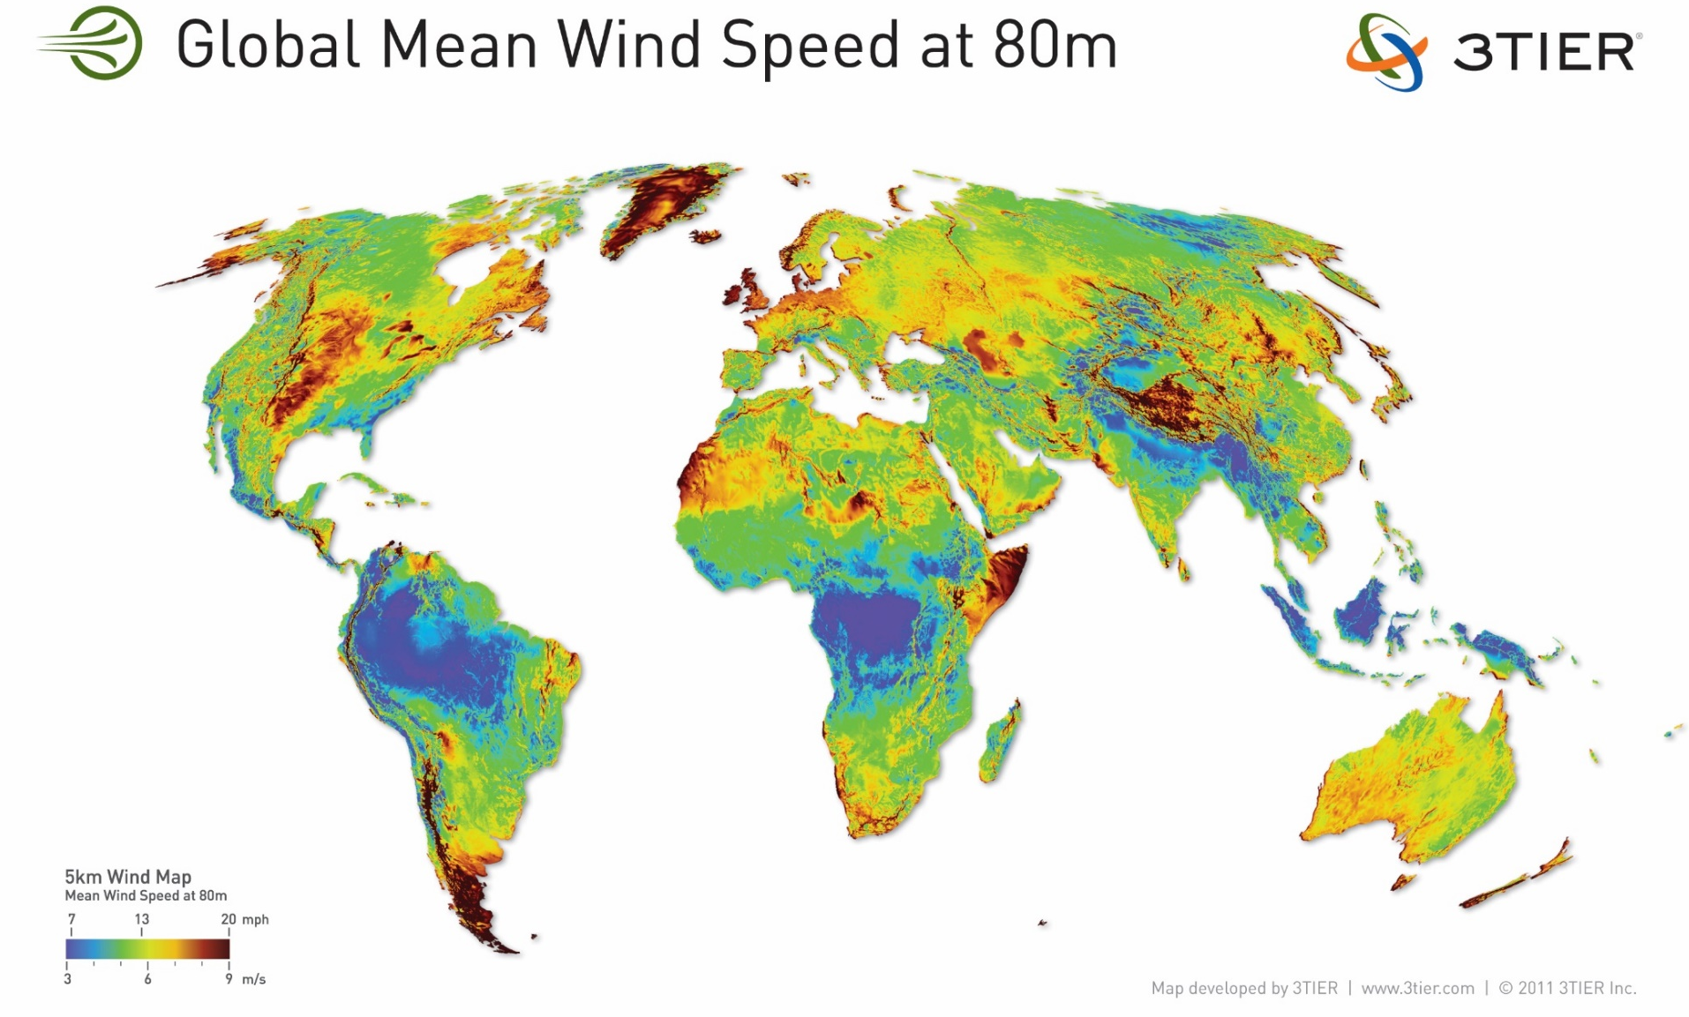
Global Wind Data
https://dupontconsulting.files.wordpress.com/2012/01/3tier_5km_global_wind_speed.jpg
Notes:
16

Slide 18
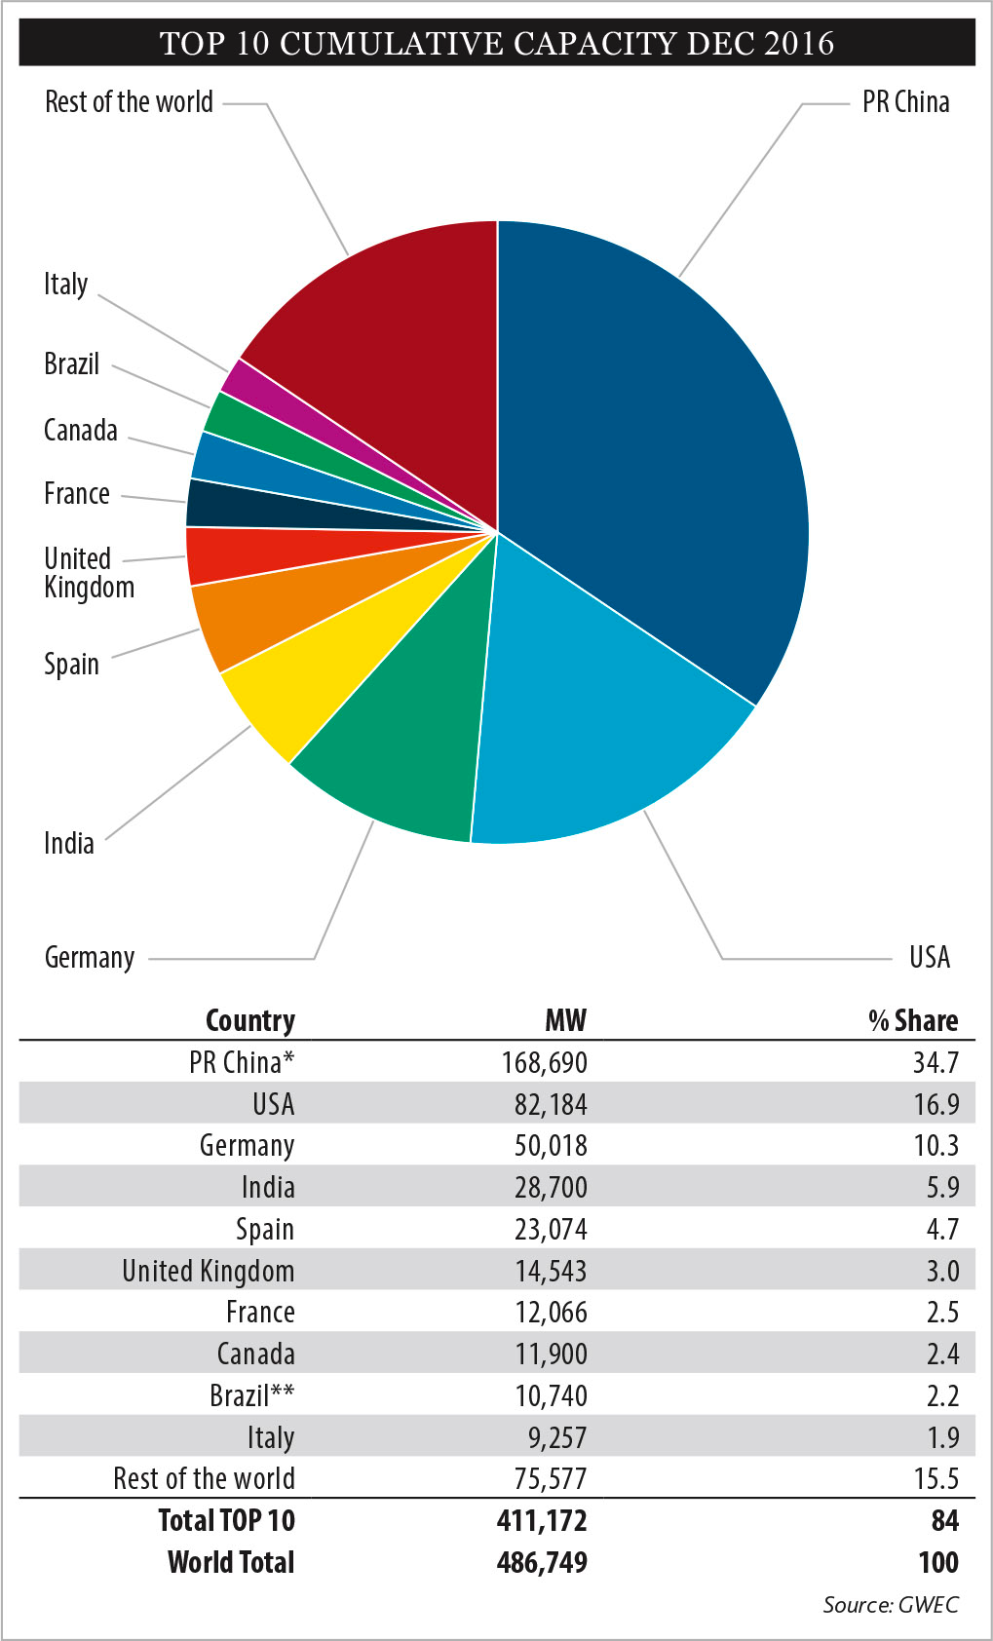
Global Wind Energy Council
http://www.gwec.net/wp-content/uploads/2017/02/3_Top-10-cumulative-capacity-Dec-2016.jpg
Notes:
17

Slide 19
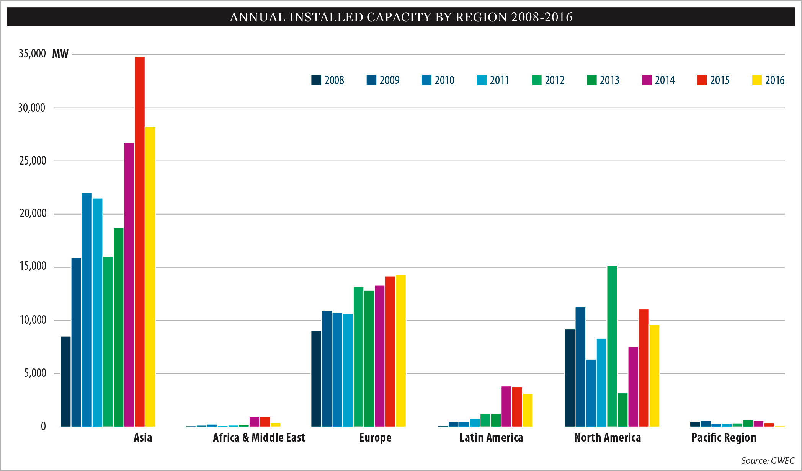
Global Annual Installed Wind Capacity
Global Wind Energy Council
http://www.gwec.net/wp-content/uploads/2017/02/6_Annual-Installed-Capacity-by-Region-2008-2016.jpg
Notes:
18

Slide 20
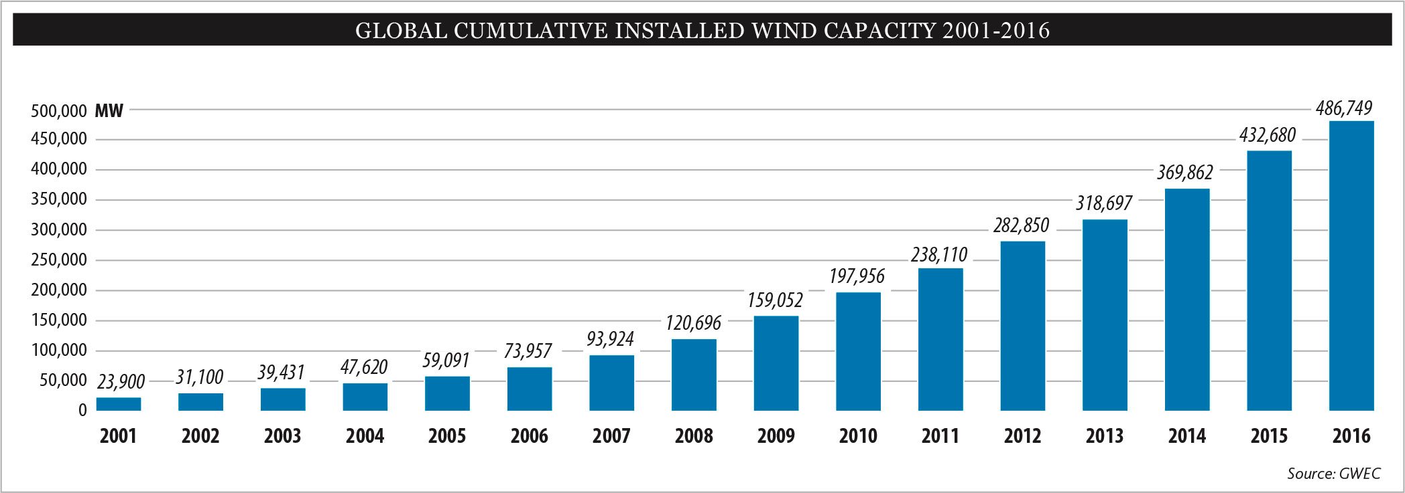
Global Installed Wind Capacity
Global Wind Energy Council
http://www.gwec.net/wp-content/uploads/2017/02/5_Global-Cumulative-Installed-Wind-Capacity-2001-2016.jpg
Notes:
19

